Slide 1
Modern AI Pro: Running first LLM

Slide 2
Summary of this session
01
02
03
04
First LLM Call
Using Langchain
With Ollama
Enabling easier access to LLMs
Building your chatbot
Multimodal LLMs
Create a full application that can be deployed.
LLMs can do beyond just text.

Slide 3
Let’s play Language models
https://rr-lm-game.herokuapp.com/

Slide 4
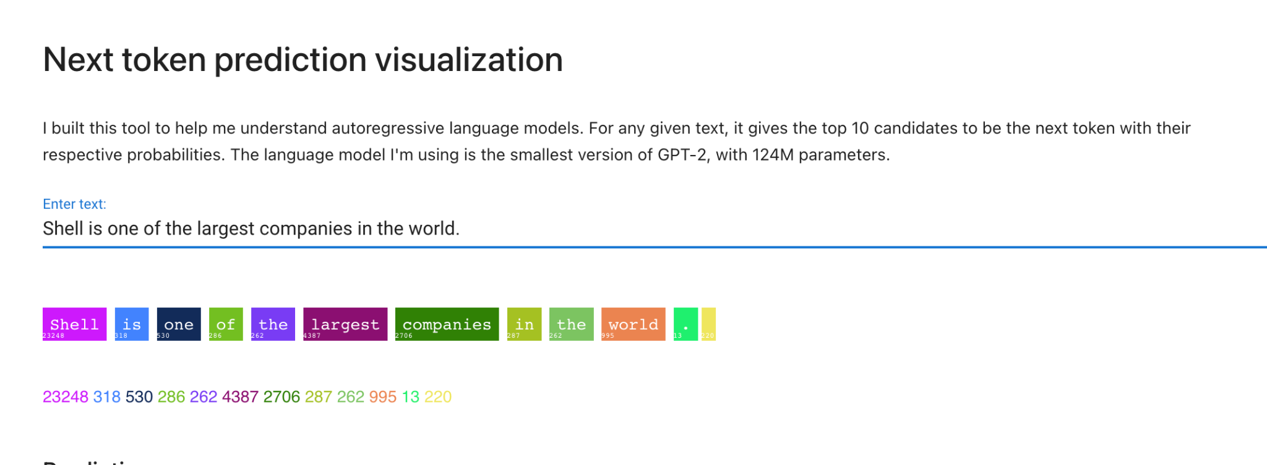
Next token prediction!!
https://huggingface.co/spaces/alonsosilva/NextTokenPrediction

Slide 5
Fill in the blanks test
https://huggingface.co/spaces/pytorch/transformers

Slide 6
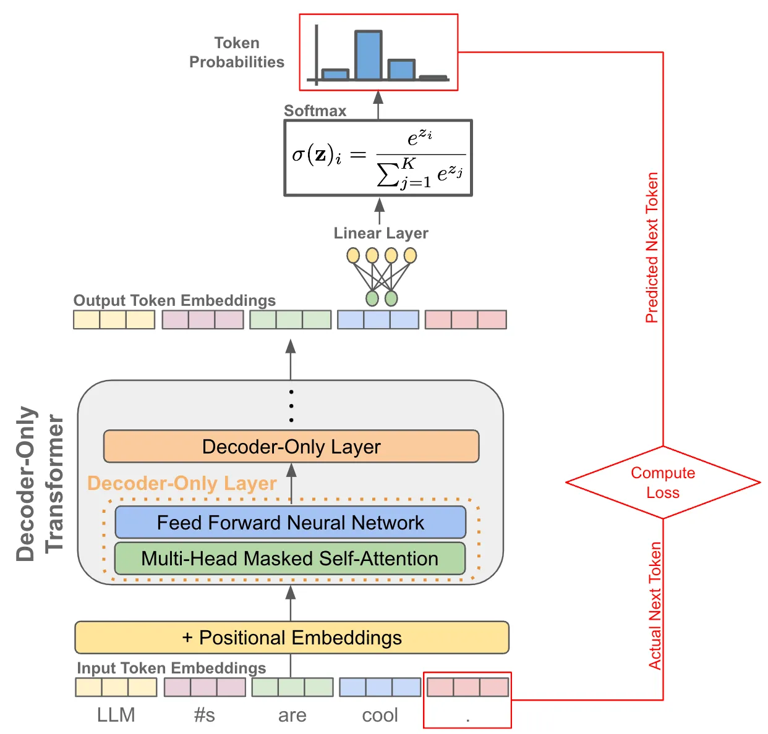
Training

Slide 7
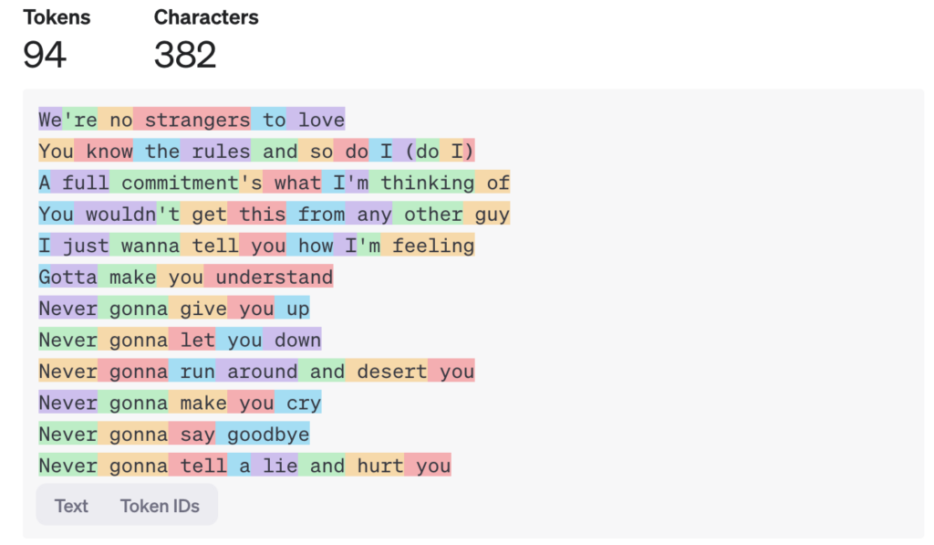
Stream output from LLMs.

Slide 8
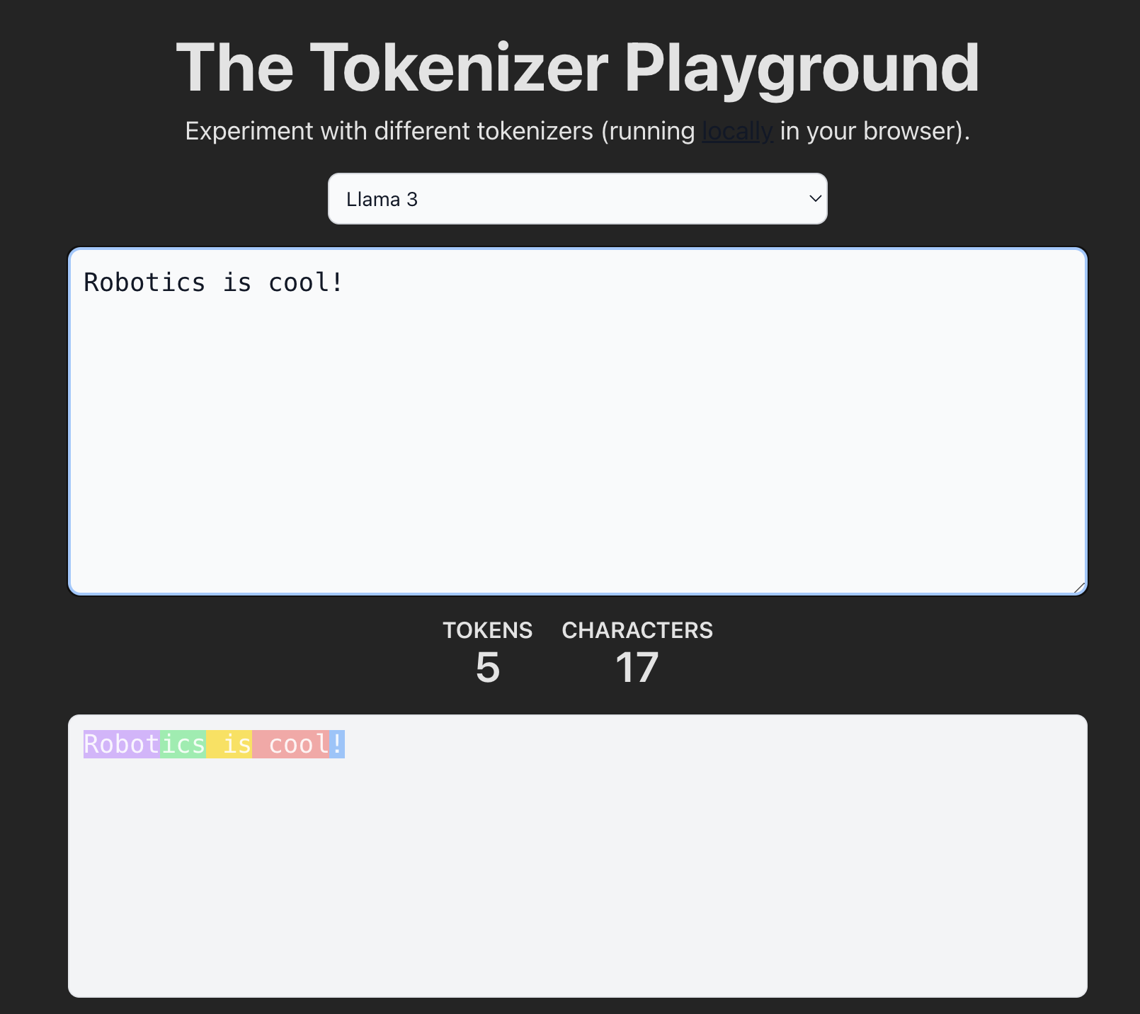
Tokenizing!
https://huggingface.co/spaces/Xenova/the-tokenizer-playground

Slide 9
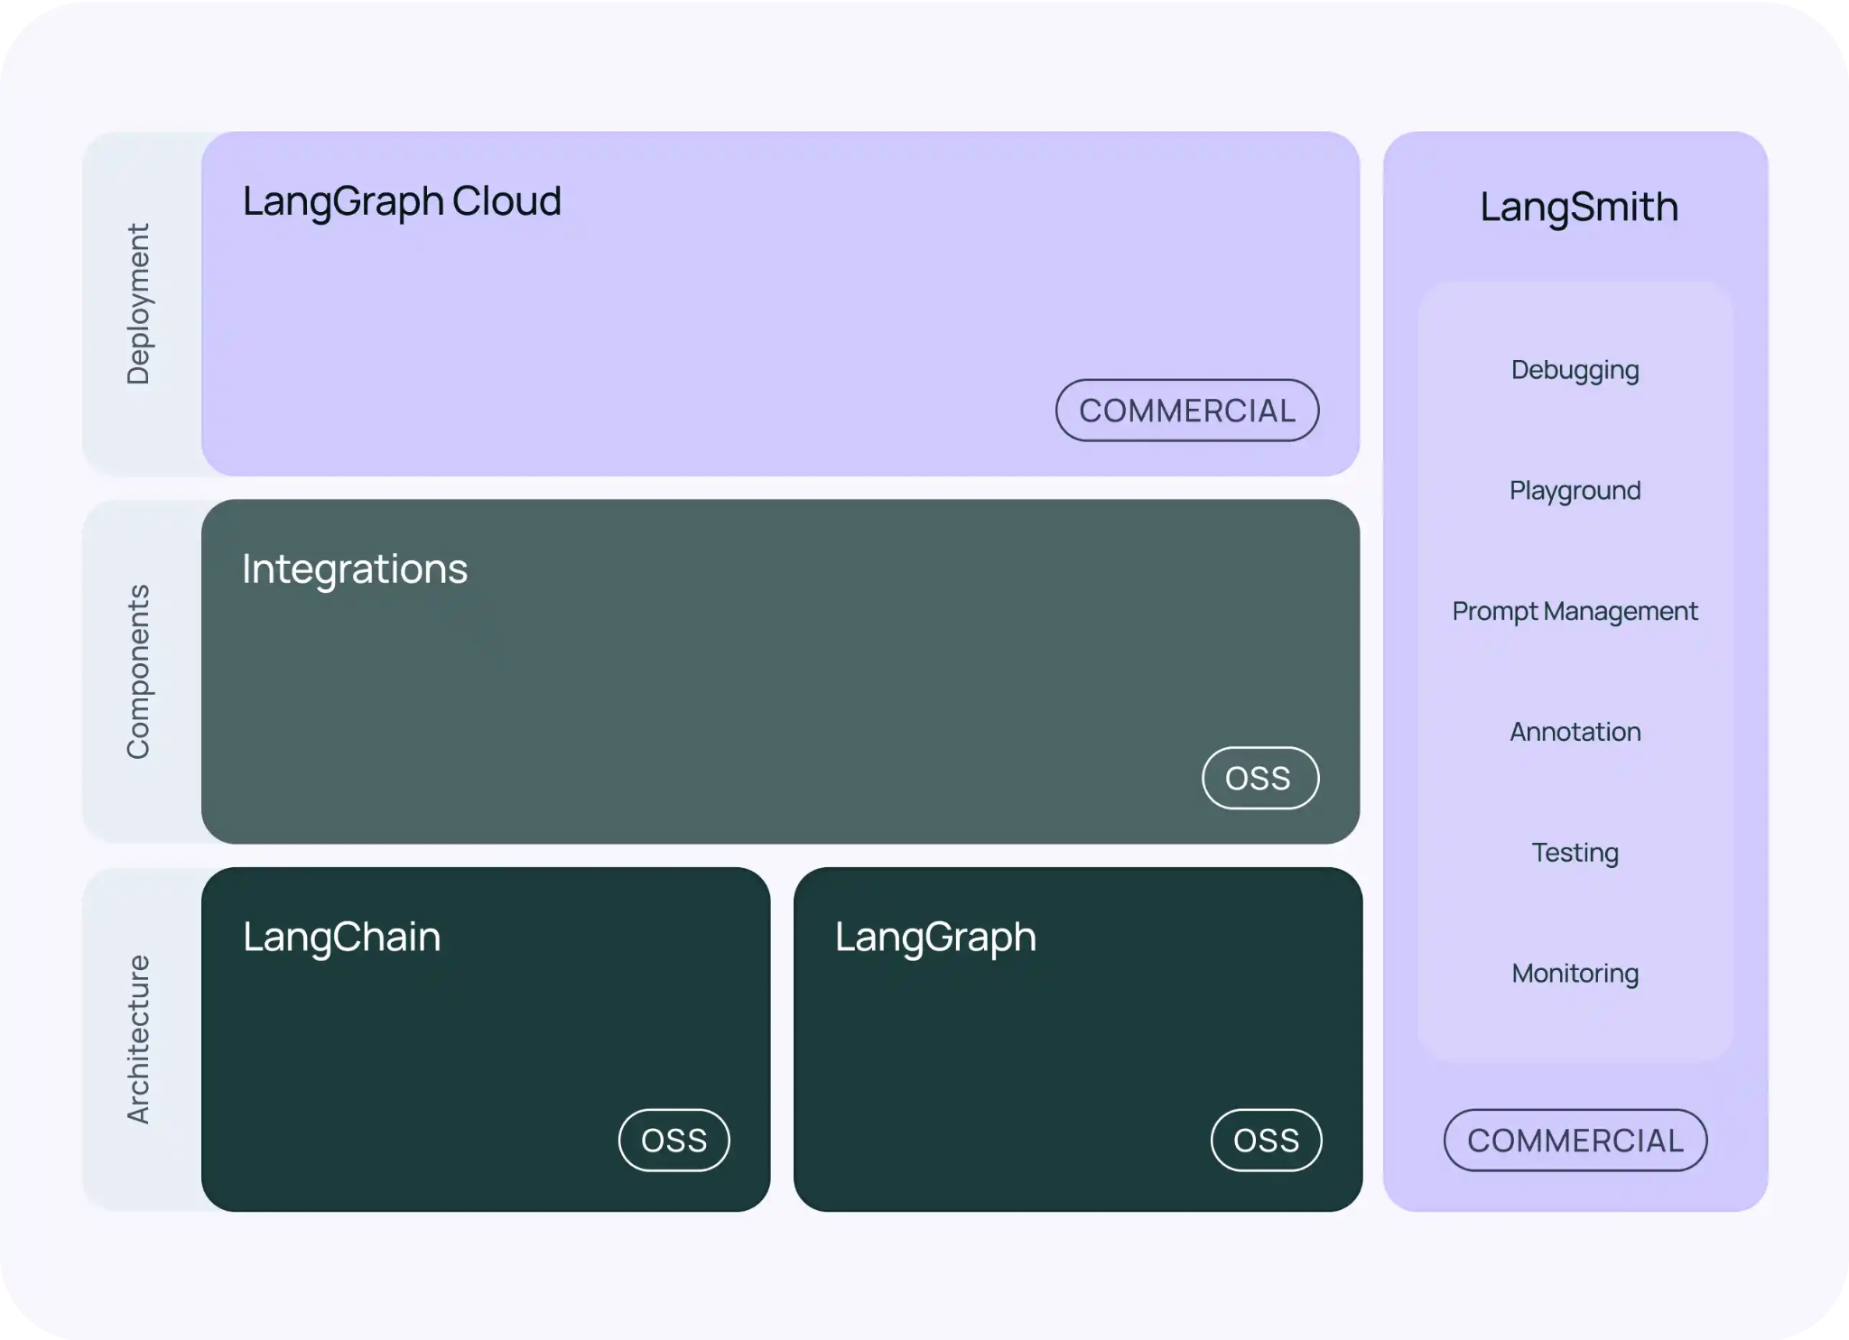
Exploring Langchain!

Slide 10
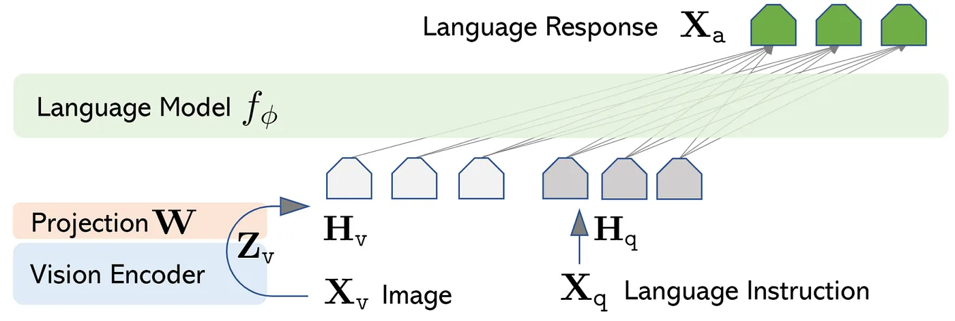
Multimodality in LLMs.

Slide 11
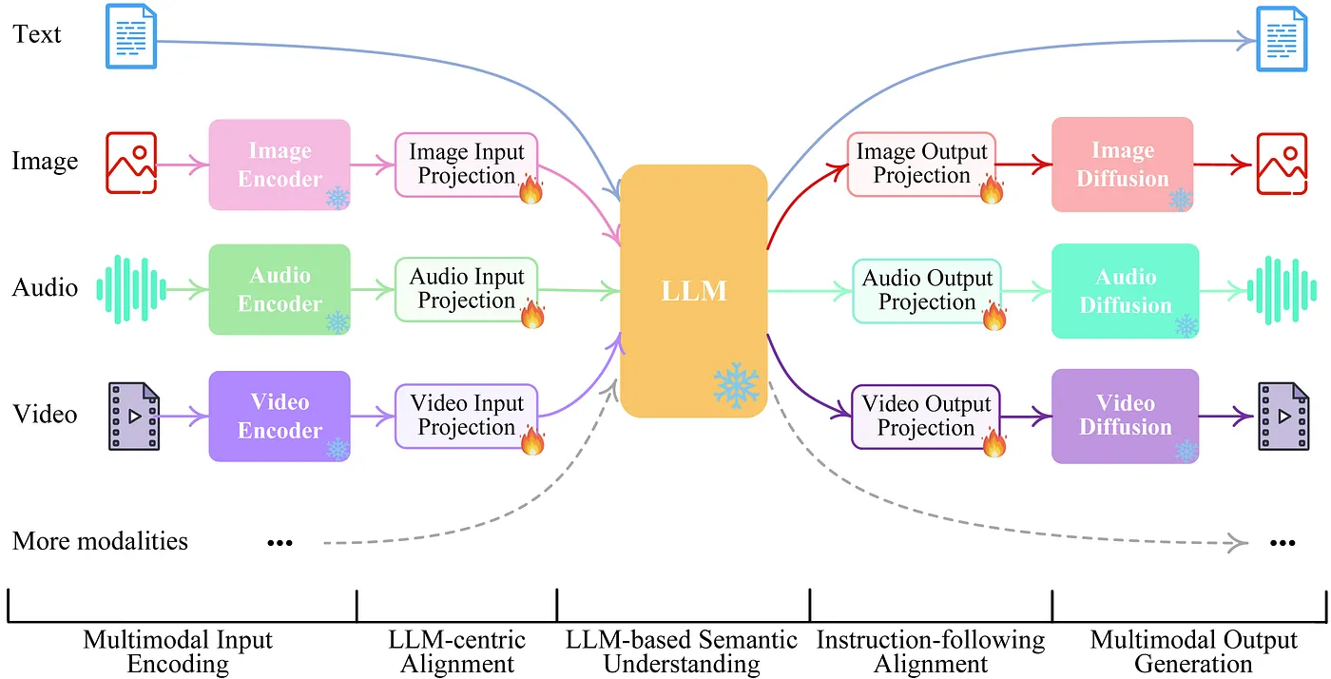
Multimodality in LLMs.

Slide 12
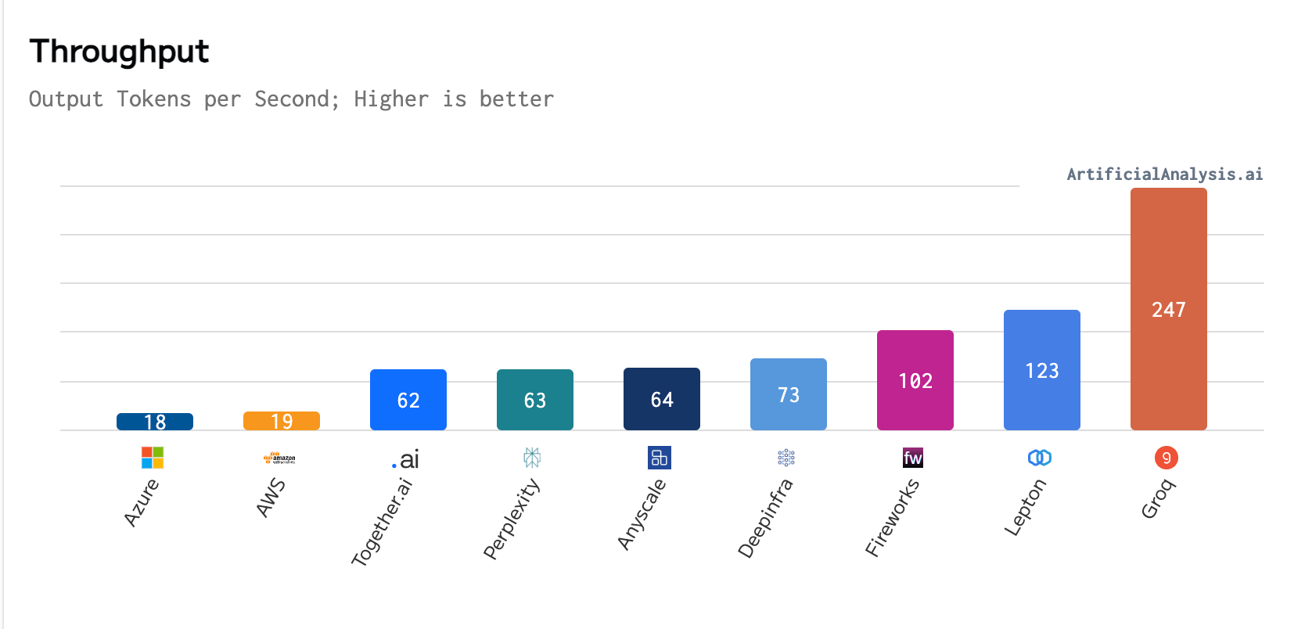
Running on Groq!

Slide 13
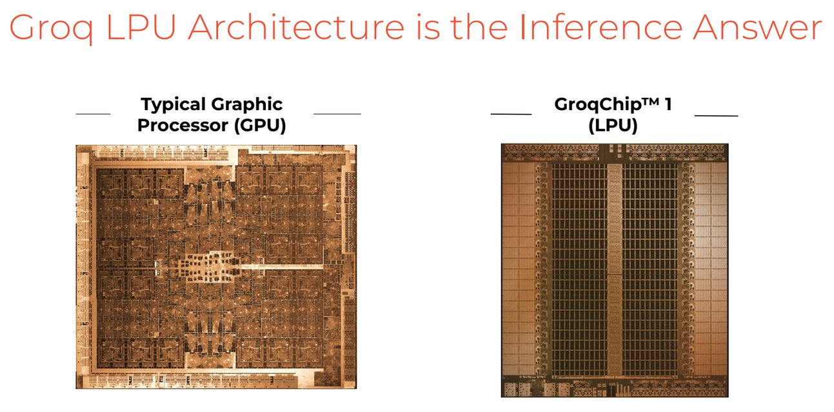
Dedicated chips for LLMs with Groq!
Buy here

Slide 14
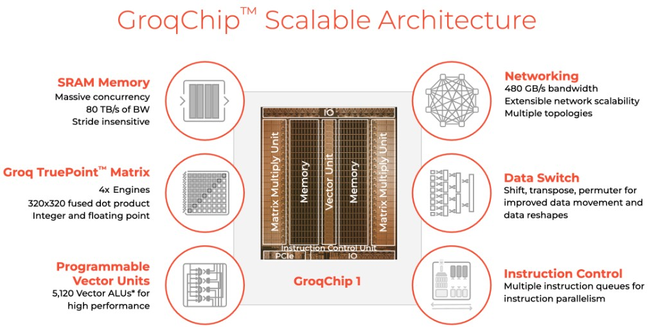
Hardware innovations in LLMs.

Slide 15
Playing with parameters of LLMs.
https://console.groq.com/playground
1. Top-p (Nucleus Sampling): Limits the set of potential next tokens to the smallest subset whose cumulative probability exceeds a specified threshold (p), focusing on more likely tokens and enabling more coherent and diverse outputs.
2. Temperature: Controls the randomness in predictions. Lower values make the model’s output more deterministic, while higher values increase diversity and creativity by allowing more varied token choices.
3. Stop Sequence: Specifies a token or sequence of tokens where the model should stop generating further output, effectively controlling the endpoint of the response.

Slide 16

Building Chatbots with Gradio

Slide 17
Gradio exploration.
https://www.gradio.app/docs

Slide 18
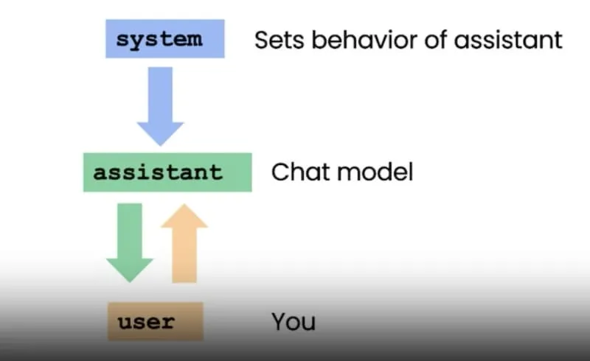
Roles in messages.

Slide 19
Loading models from from Huggingface
1. device_map="auto": Automatically distributes the model across available hardware (CPU/GPU) to optimize performance and memory usage.
2. torch_dtype="auto": Dynamically selects the best precision (e.g., float16 or float32) based on the hardware, enhancing efficiency and speed.
3. use_safetensors=True: Ensures faster and safer model loading by using a secure, optimized file format.

Slide 20
